Slide 1
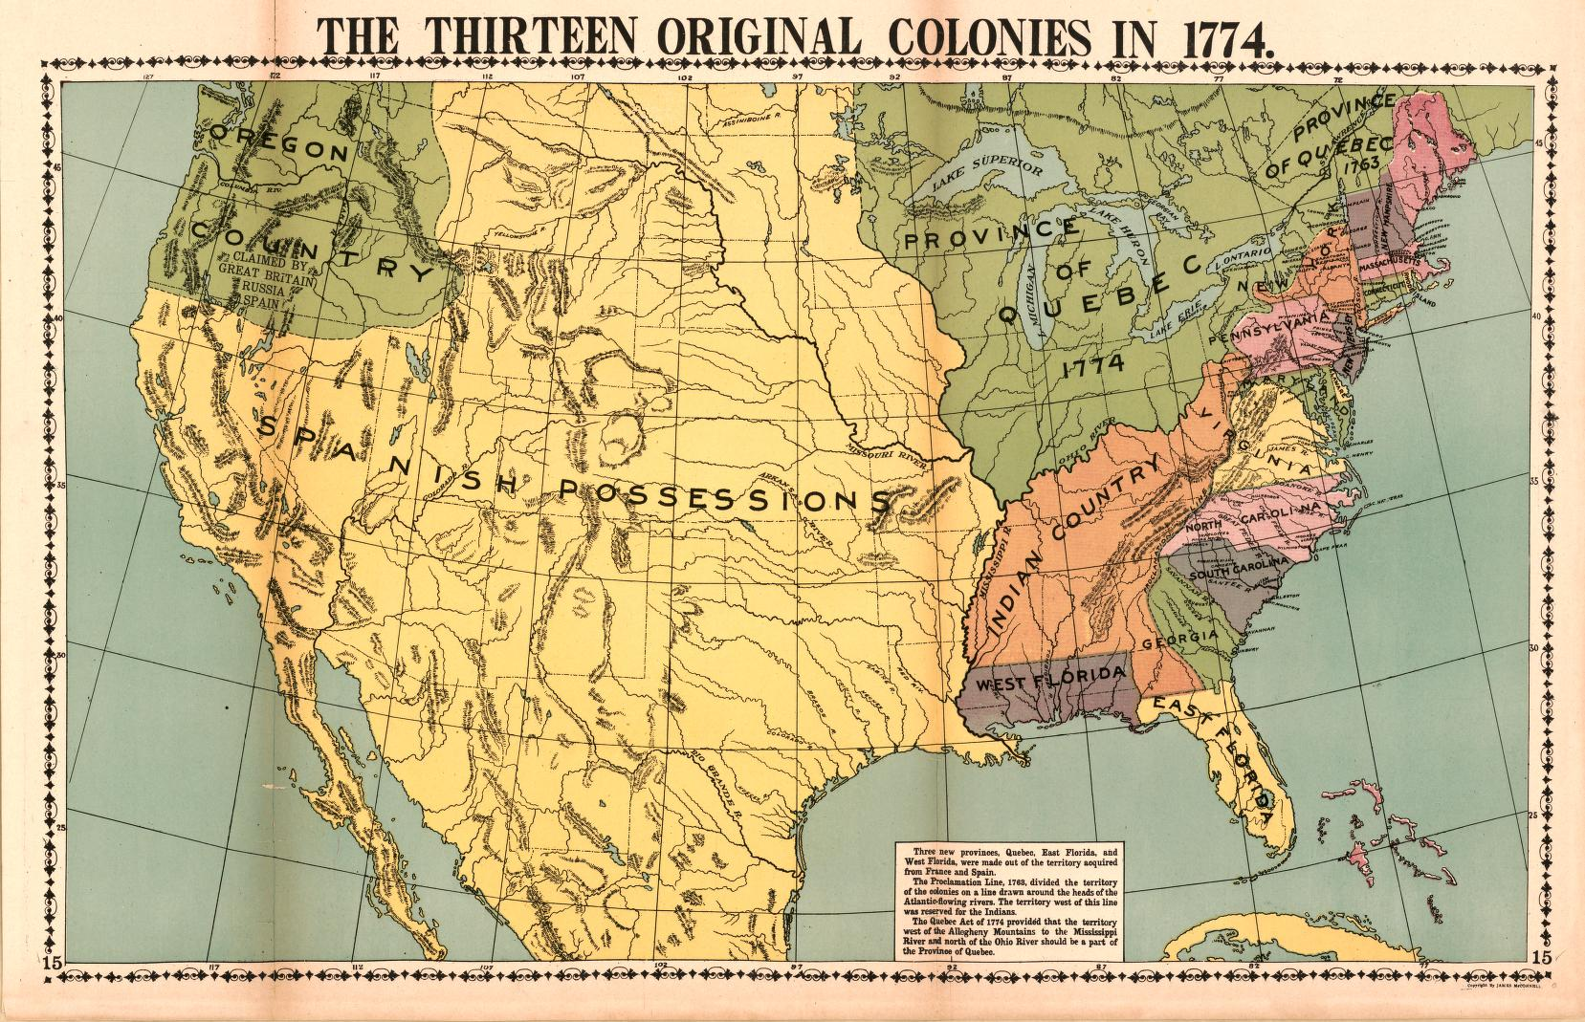
Trouble in the Colonies
Part 1- Tighter British Control

Slide 2
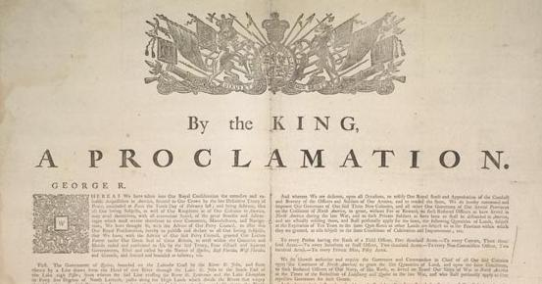
What was the purpose of the Proclamation of 1763?
It was to prevent the British colonists from settling west of the Appalachian Mountains.

Slide 3
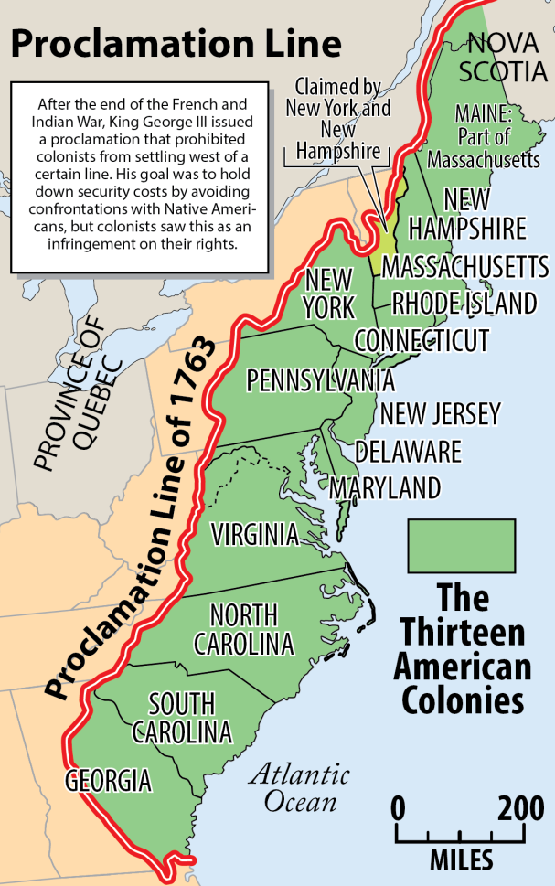
Why did the British government not want their colonists to settle west of the Proclamation Line of 1763?
-They wanted peace, and they didn’t want to fight another war.

Slide 4
How did colonists feel about the Proclamation?
-Those who were affected by it were upset and felt like they were wronged.

Slide 5
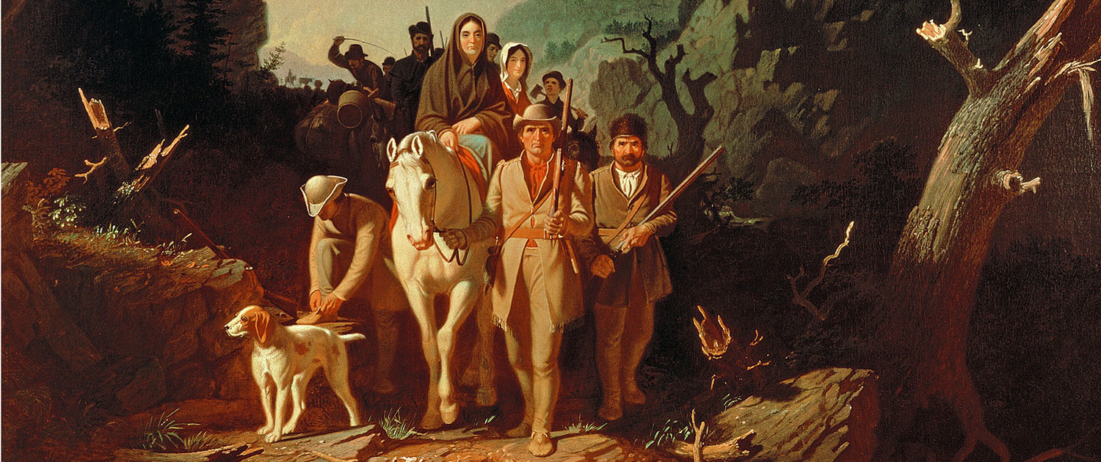
Some colonists ignored the Proclamation and settled in the Ohio River Valley anyway.

Slide 6
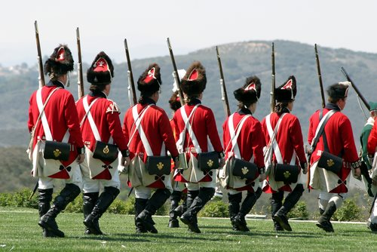
To try to enforce the Proclamation of 1763, King George III decided to leave 10,000 British soldiers in the colonies.

Slide 7
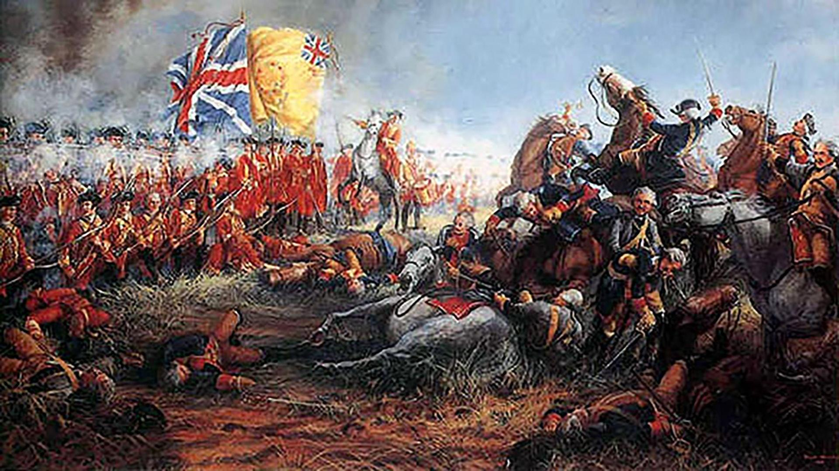
The French and Indian War and Pontiac’s Rebellion cost a lot of money. Even though Britain won, the conflicts left them in debt.

Slide 8
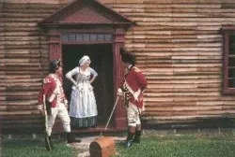
To help pay for the 10,000 British soldiers left to enforce the Proclamation of 1763, in 1765, Parliament passed the Quartering Act. It required the colonists to provide housing and supplies (to quarter) the soldiers.

Slide 9
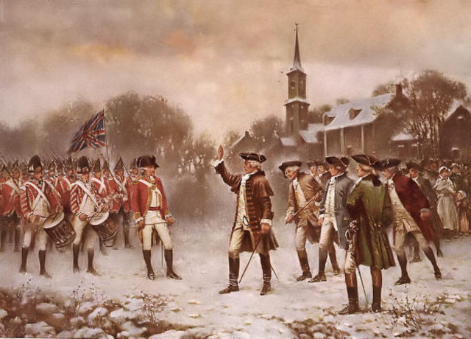
Many of these soldiers were staying in New York under the command of General Gage. Many colonists were upset by this act. Some refused to follow the rule, including the New York assembly which refused to pay to house the troops.

Slide 10
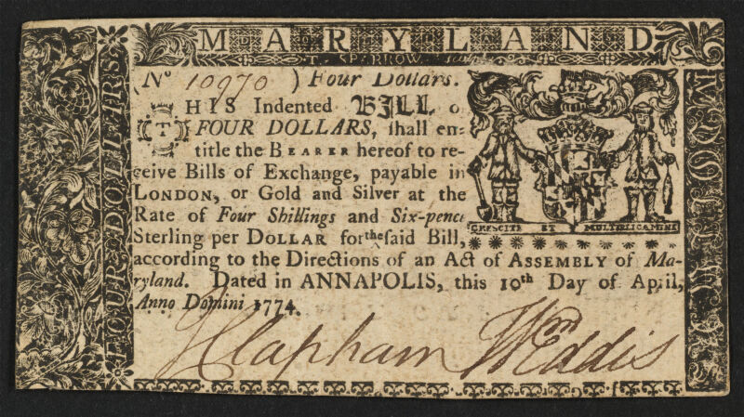
Britain needed a way to get more revenue (income) to help pay off its debt. It made sense to them to have the American colonies help pay off the debt since they benefitted from the wars that caused Britain to go into debt.

Slide 11
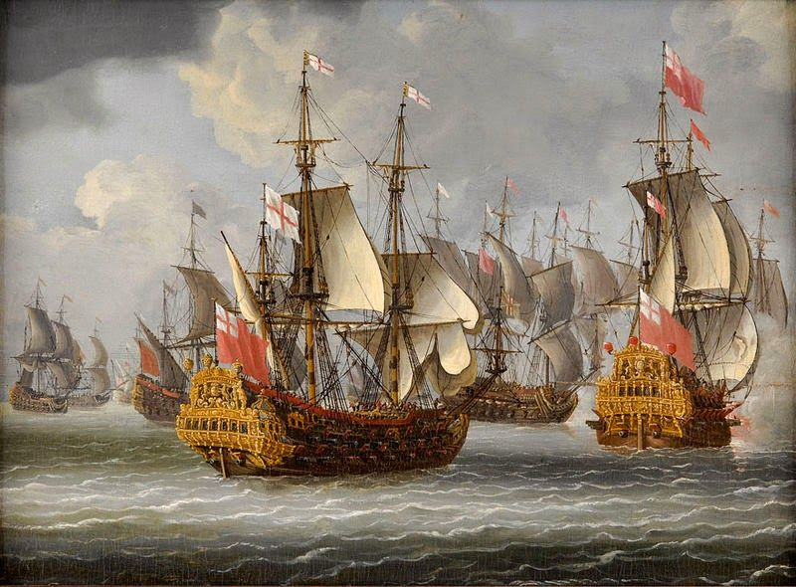
Britain started to enforce the Navigation Acts more by cracking down on smuggling.

Slide 12
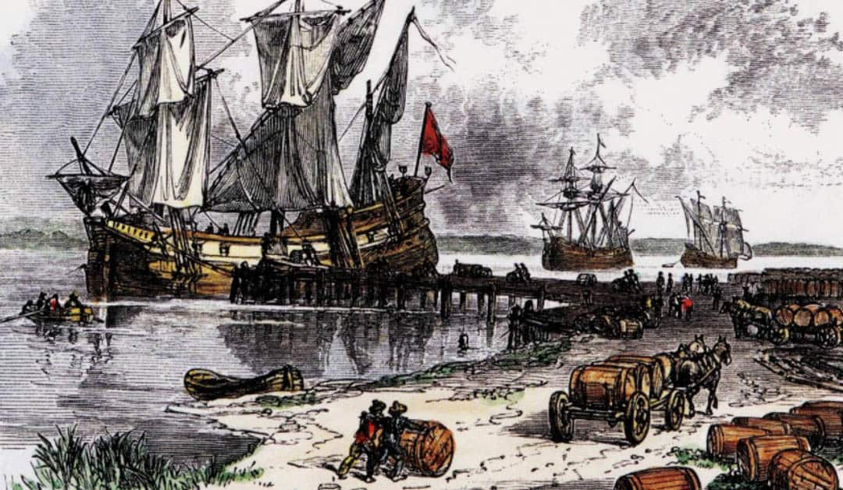
Parliament also passed laws forcing the colonists to pay more for imported goods.

Slide 13
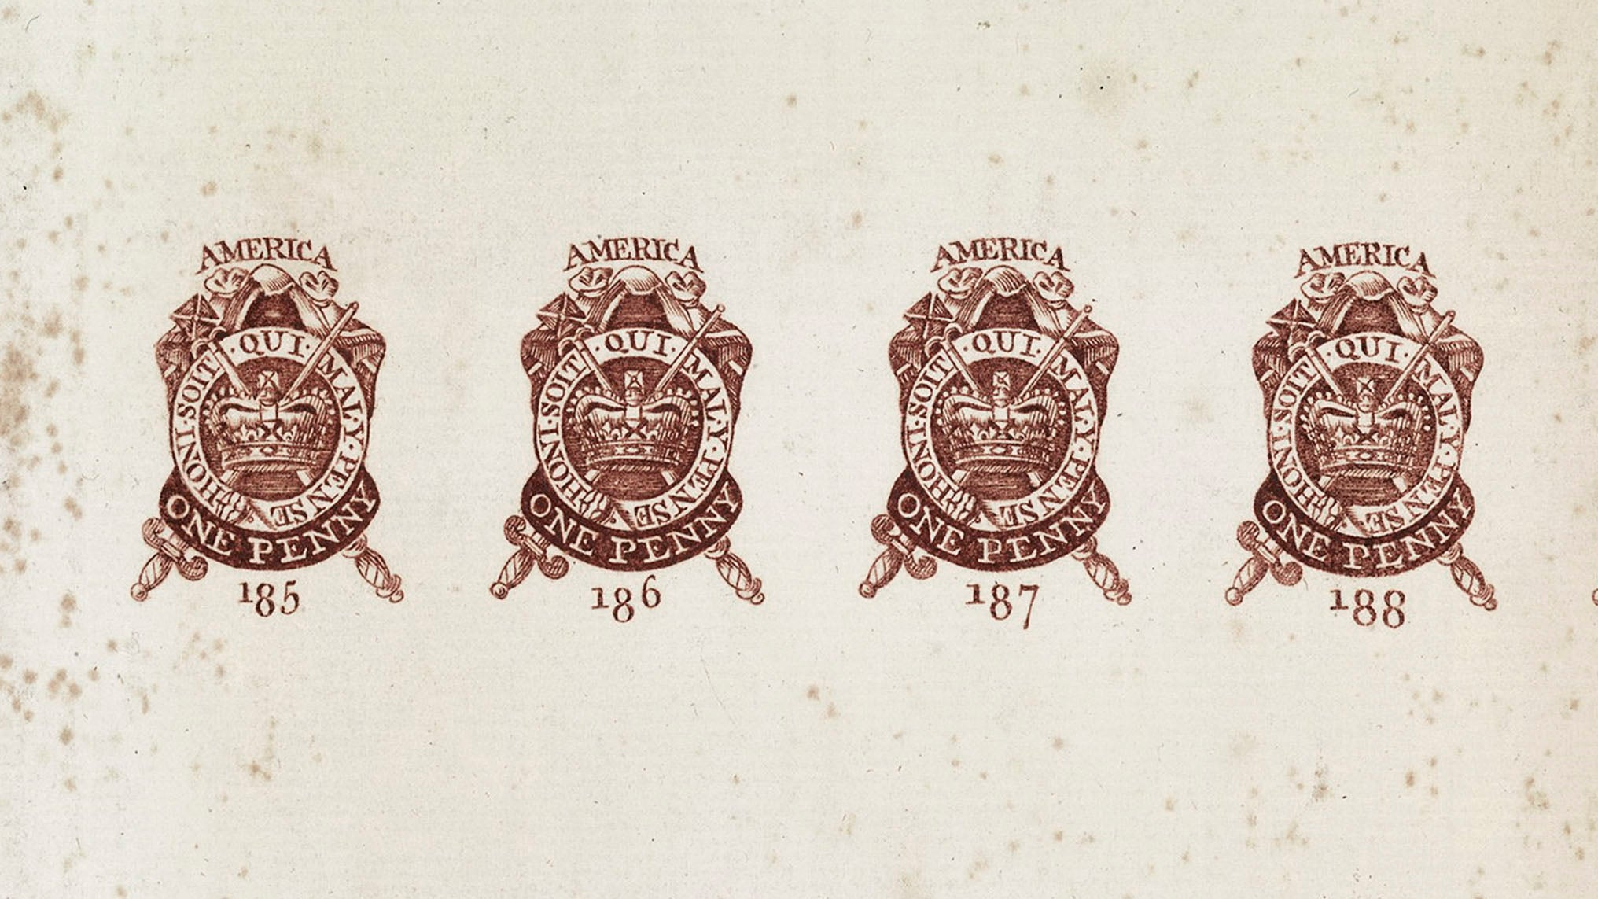
In 1765 Parliament passed the Stamp Act which was a way for Britain to tax the colonists directly.

Slide 14
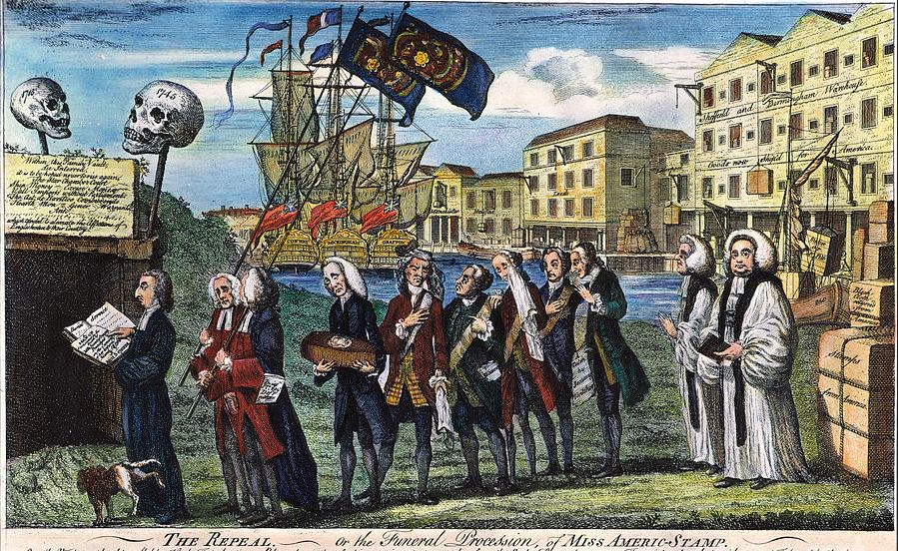
The Stamp Act required colonists to use paper that had a special stamp on it. People had to go to a stamp-tax office to buy the stamped paper.

Slide 15
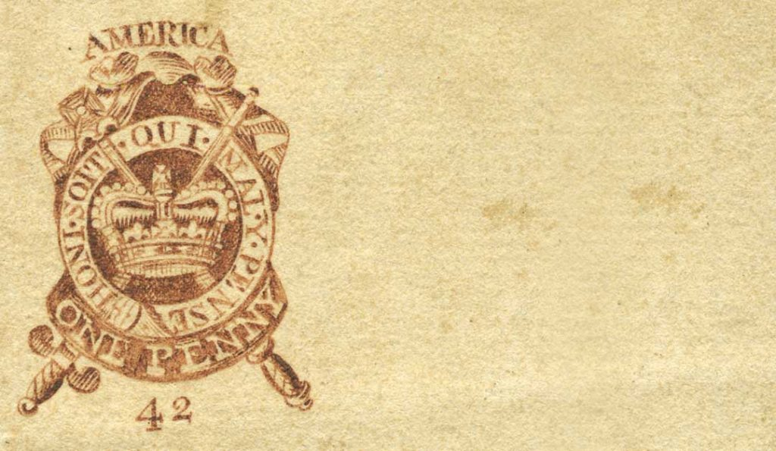
Things like legal documents, newspapers, advertisements, wills, and even playing cards had to have a stamp on it.
The Stamp Act

Slide 16
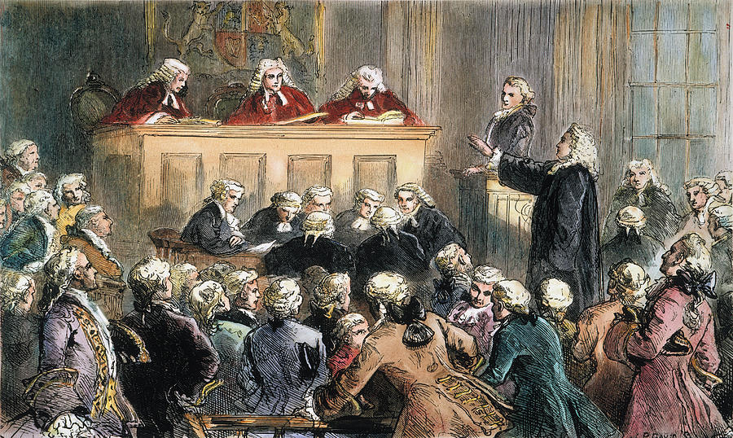
People caught using illegal paper could be taken to court where there was no trial by jury.

Slide 17
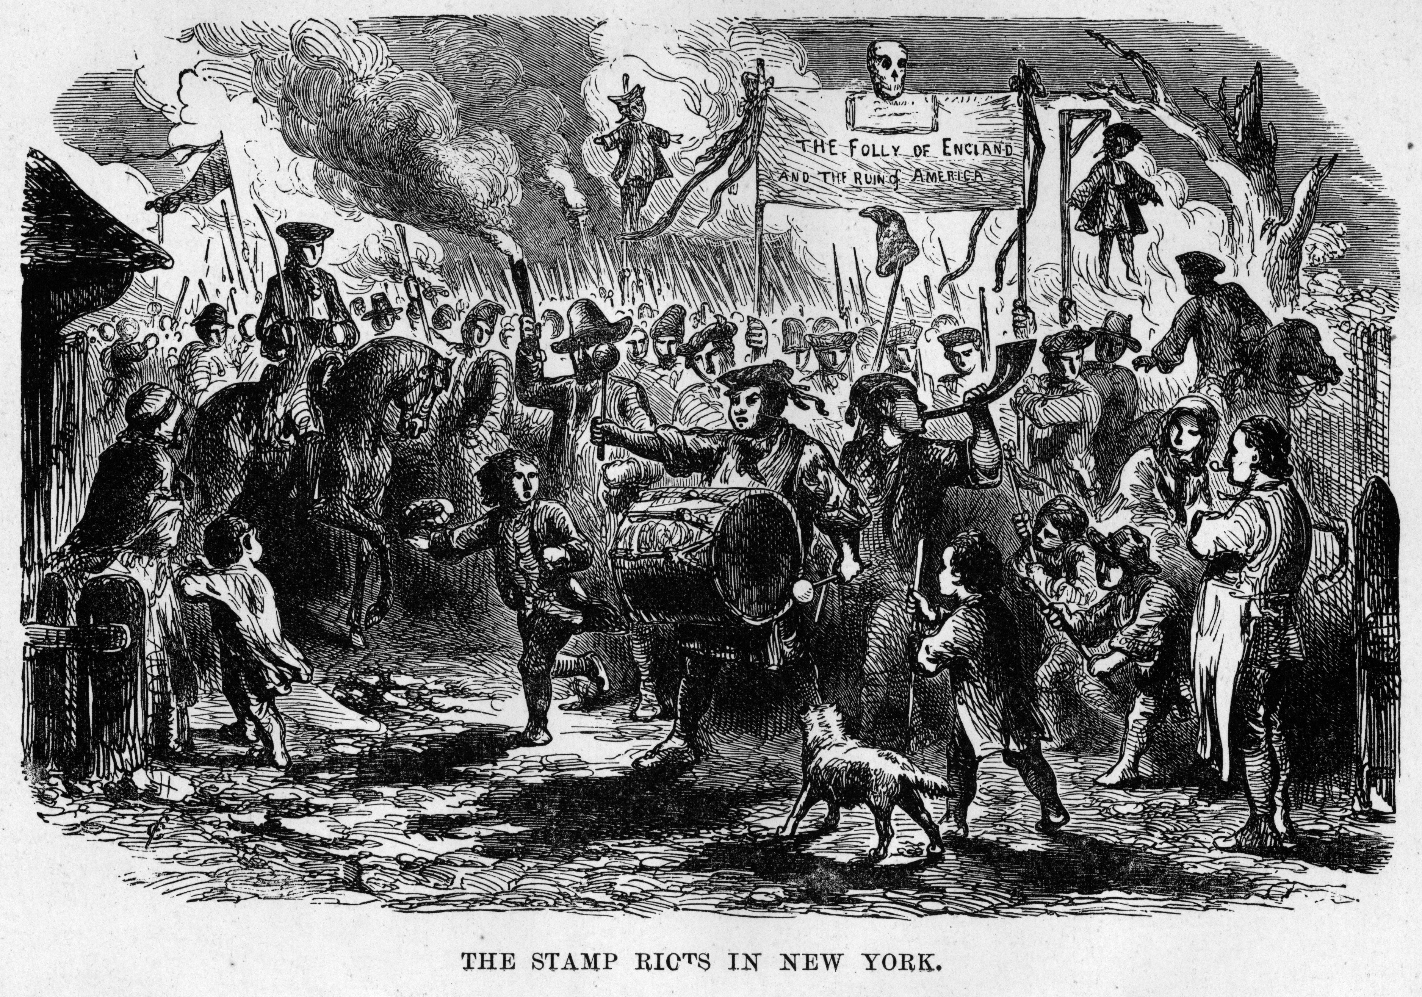
Colonists were outraged! Many were upset because they believed that Parliament did not have the right to tax the colonies, especially since the colonists did not have any representatives in Parliament.

Slide 18
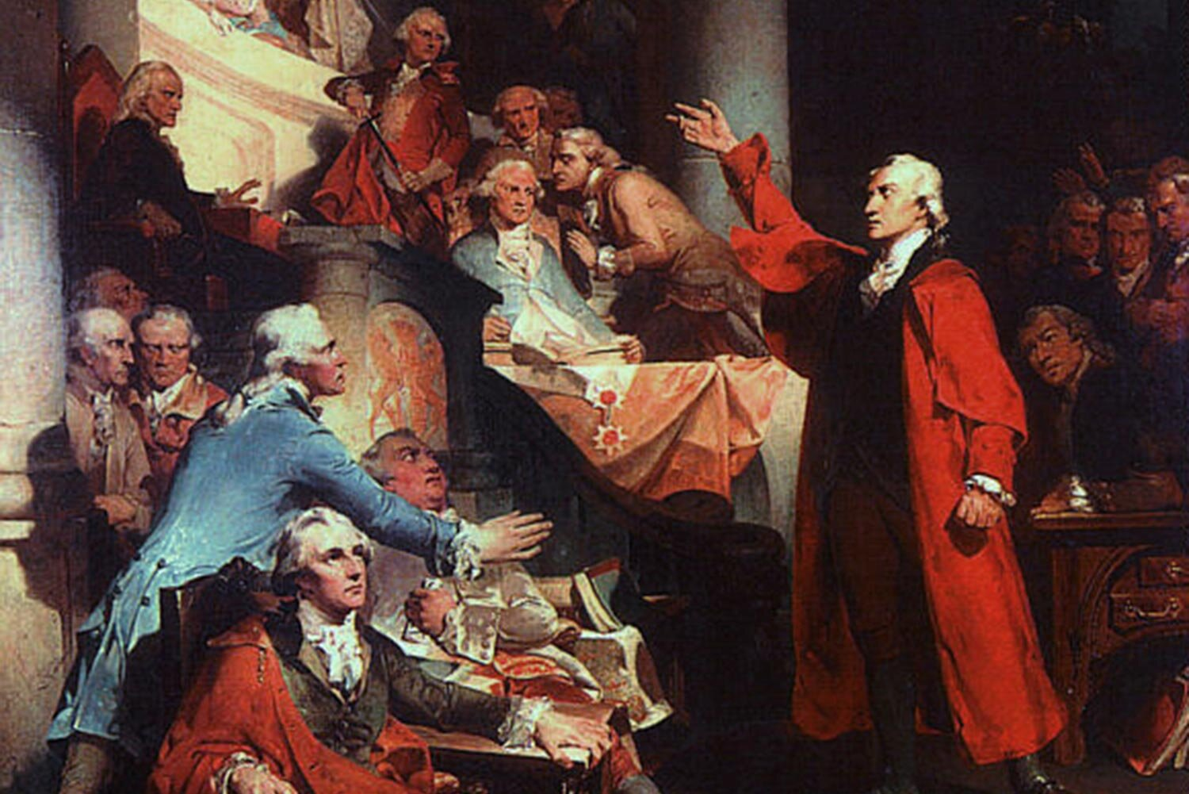
Nine colonies sent delegates (or representatives) to the Stamp Act Congress in New York City in October of 1765 to discuss what could be done.

Slide 19
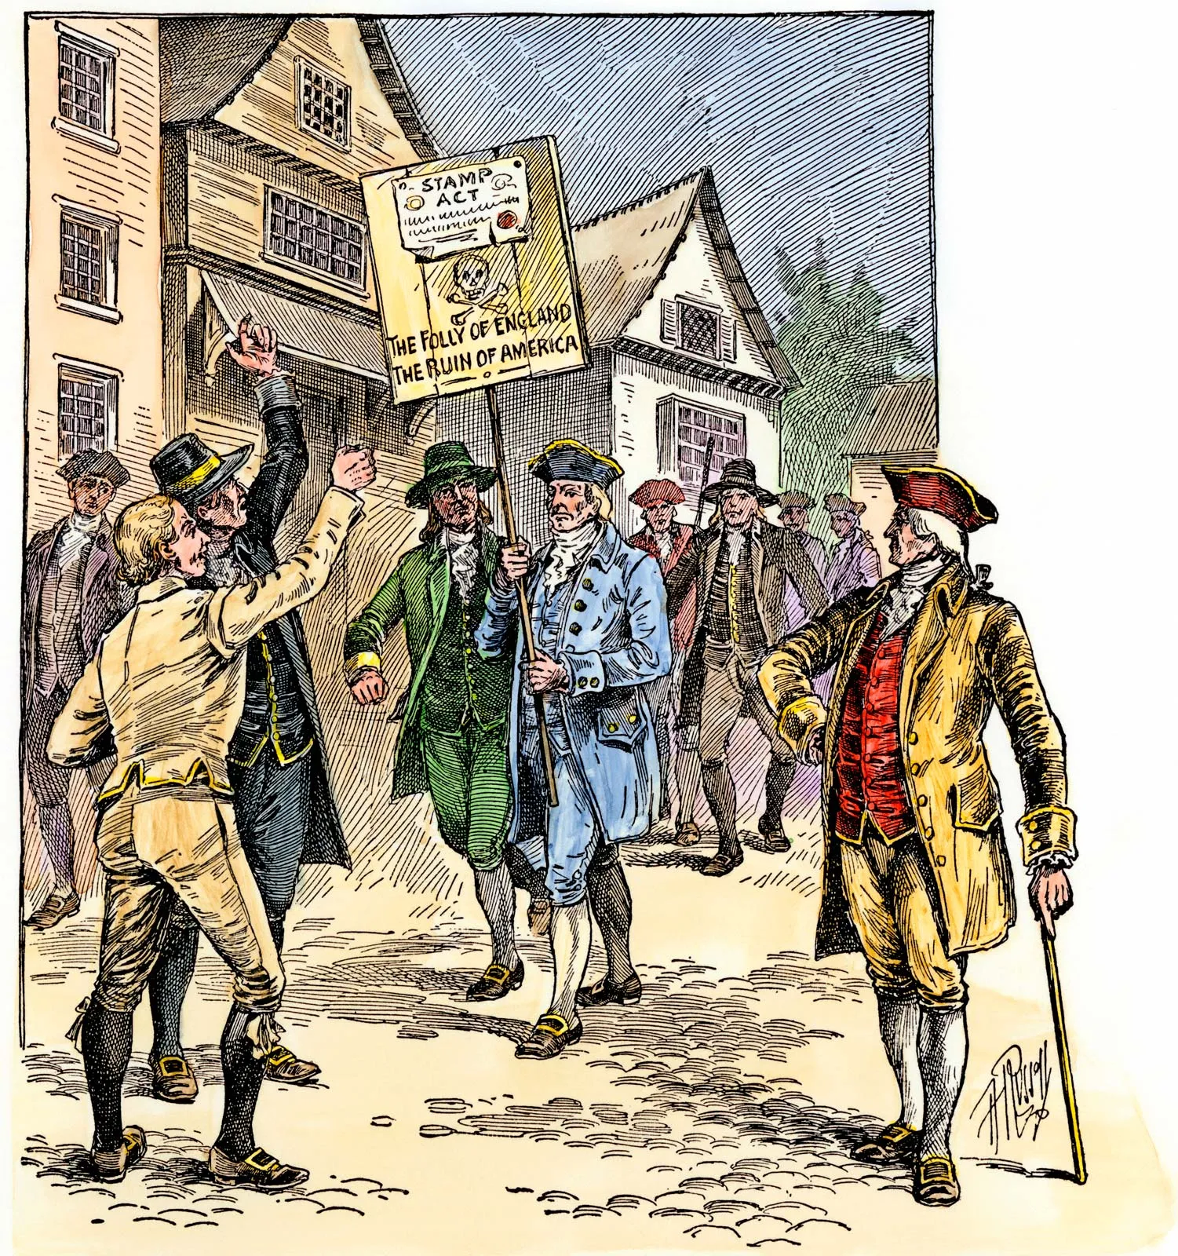
The delegates wrote a petition which declared that the right to tax the colonists belonged to the colonial assemblies, not Parliament.

Slide 20
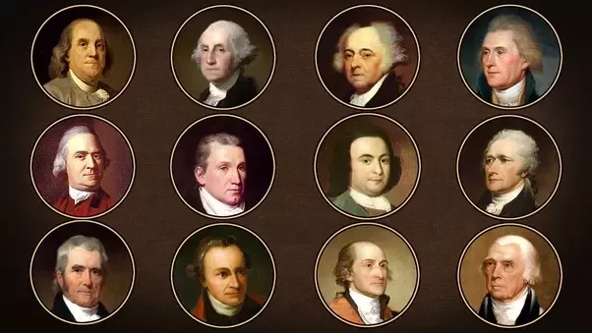
A group that called themselves Sons of Liberty formed in the summer of 1765 in protest of the Stamp Act.

Slide 21
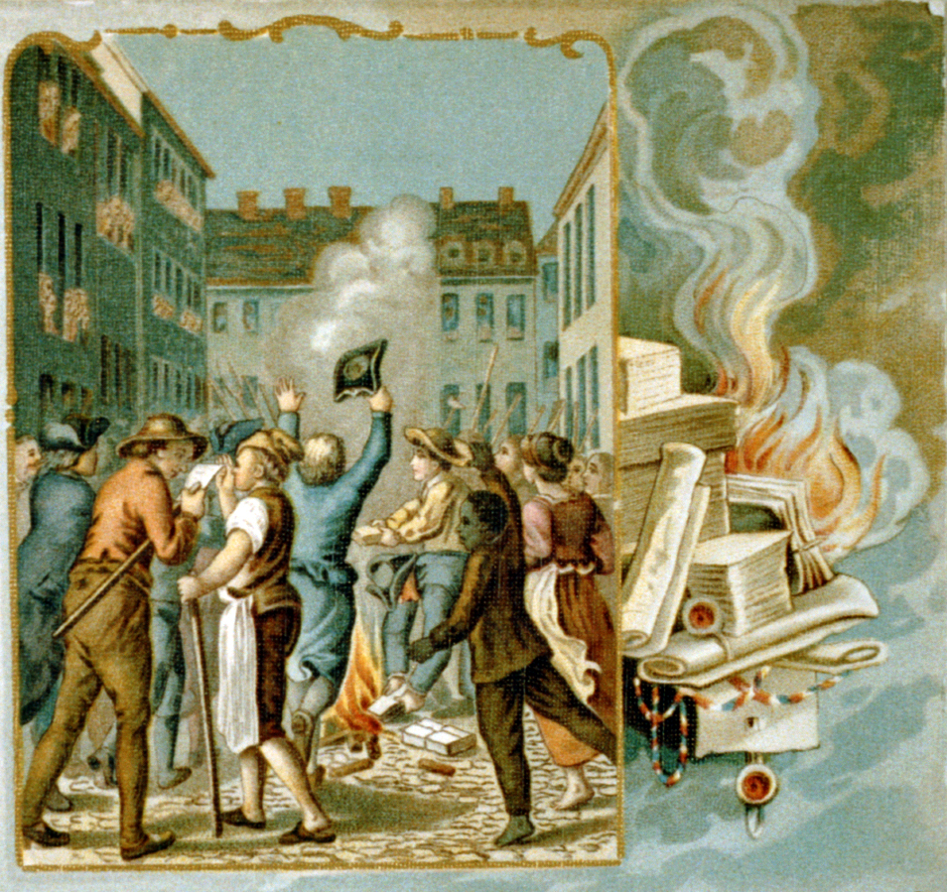
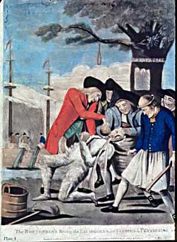
They staged protests, burned the stamp paper, and tarred and feathered customs officials (people who collected taxes for the British government).

Slide 22
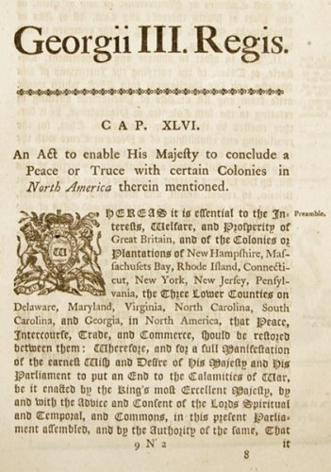
In 1766, Parliament passed the Declaratory Act in response to the protests. This law stated that Parliament had the right to rule and tax the colonies “in all cases whatsoever.”

Slide 23
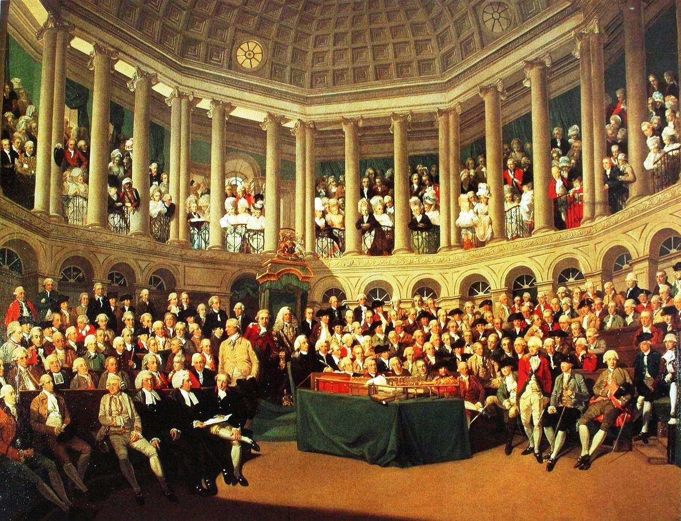
The main question that now needed to be answered was how much authority did Parliament have over the colonies?

